Slide 1
FINITE DIFFERENCE
In numerical analysis, two different approaches are commonly used: The finite difference and the finite element methods. In heat transfer problems, the finite difference method is used more often and will be discussed here. The finite difference method involves:
➢ Establish nodal networks
➢ Derive finite difference approximations for the governing
equation at both interior and exterior nodal points
➢ Develop a system of simultaneous algebraic nodal equations
➢ Solve the system of equations using numerical schemes

Slide 2
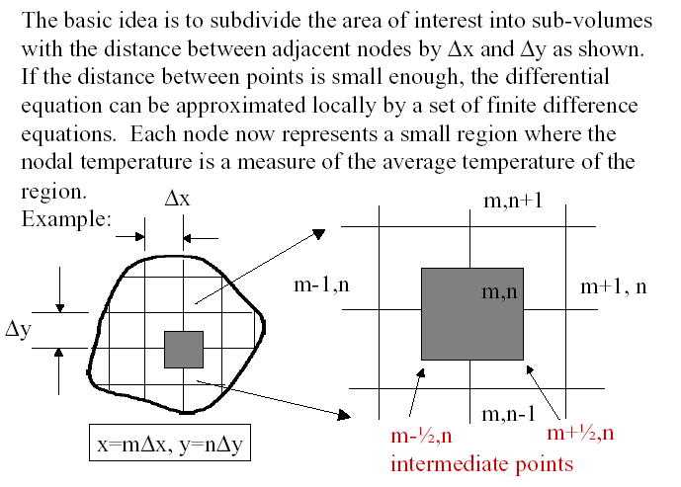
The Nodal Networks

Slide 3
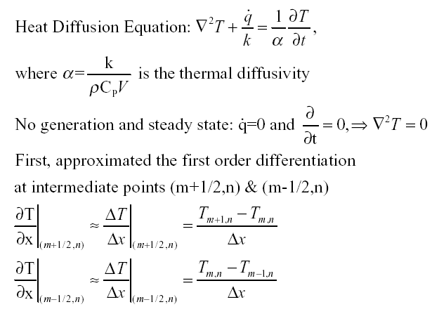
Finite Difference Approximation

Slide 4
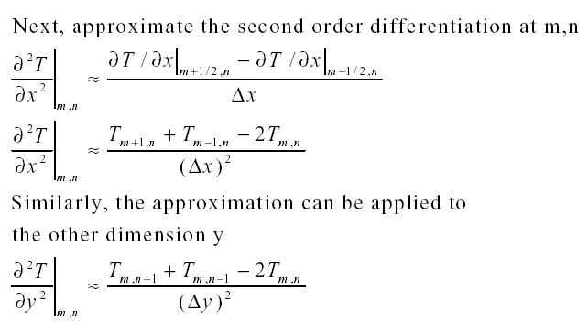
Finite Difference Approximation cont.

Slide 5
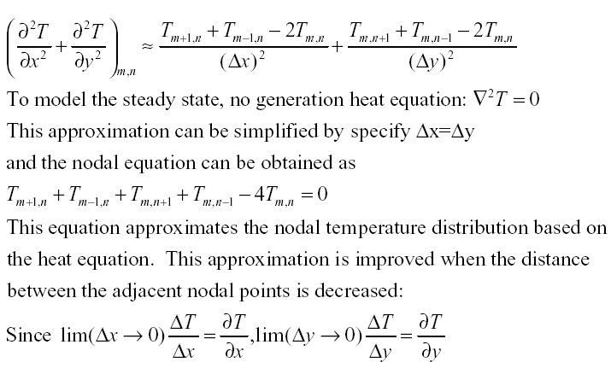
Finite Difference Approximation cont.

Slide 6
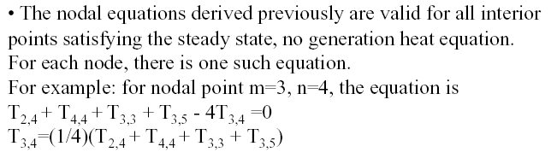
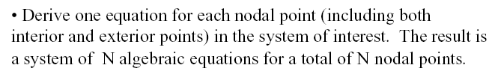
A System of Algebraic Equations

Slide 7
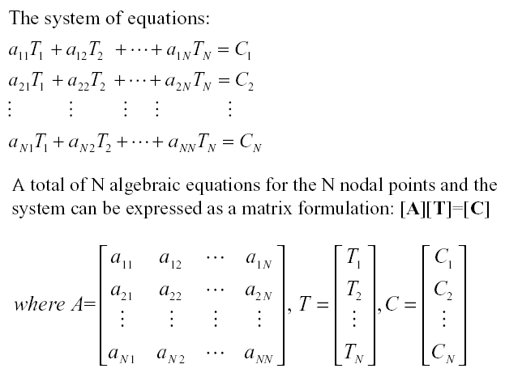
Matrix Form

Slide 8
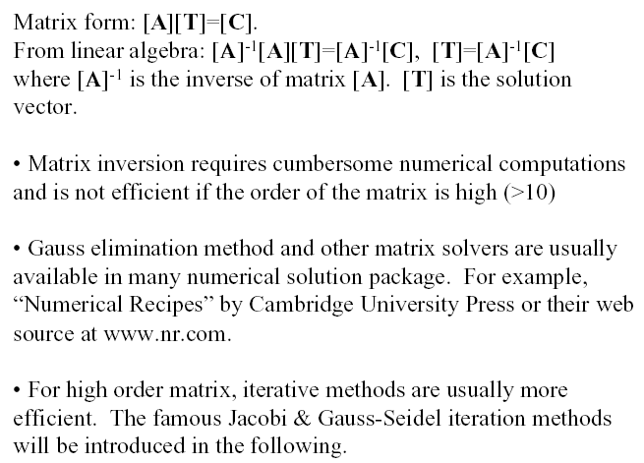
Numerical Solutions

Slide 9
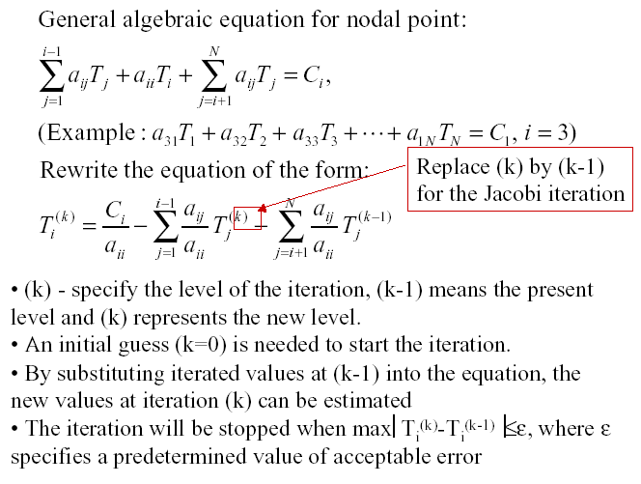
Iteration

Slide 10
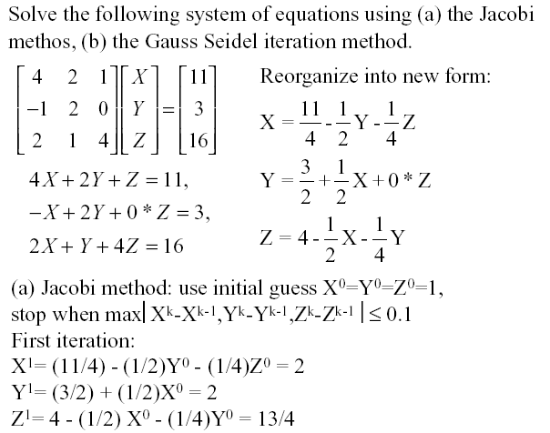
Example

Slide 11
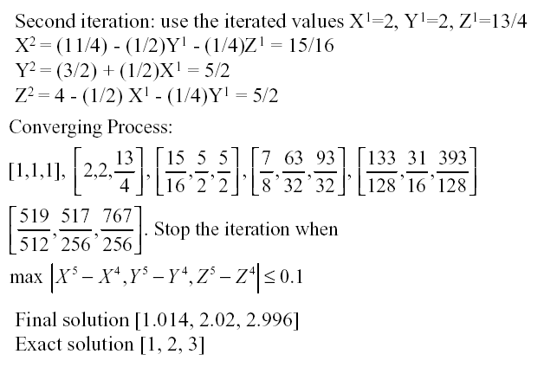
Example (cont.)

Slide 12
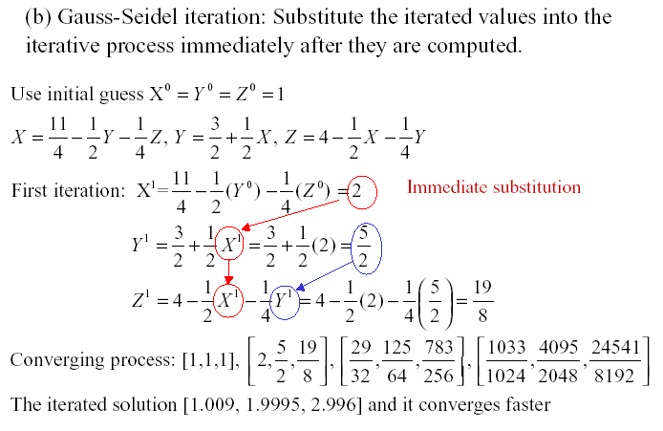
Example (cont.)

Slide 13
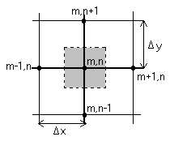

Summary of nodal finite-difference relations for various configurations:
Case 1 Interior Node

Slide 14
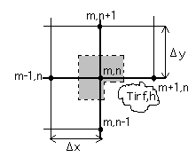
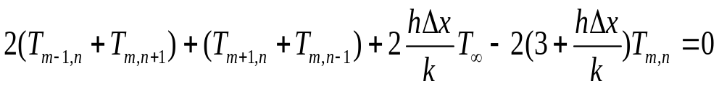
Case 2
Node at an internal corner with convection

Slide 15
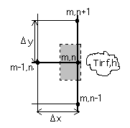
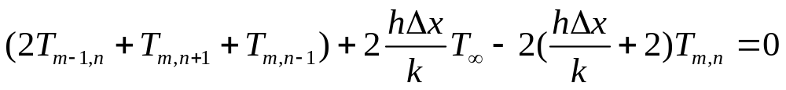
Case 3
Node at a plane surface with convection

Slide 16
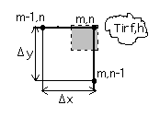
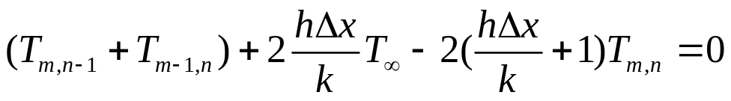
Case 4
Node at an external corner with convection

Slide 17
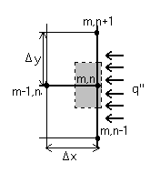
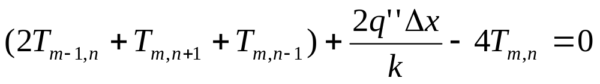
Case 5
Node at a plane surface with uniform heat flux

